Slide 1
IN609
Operations Engineering 1
Introduction to Azure with Power Shells
Lecture 4-1
Semester 2, 2021

Slide 2
Overview
Up to now we talked about most essential concepts with Powershell
Today we will see how powershell can be used to do operations on Microsoft’s Azure Cloud platform
3

Slide 3
Learning Outcomes
Identify key tools/services for operating cloud platforms
Investigate Cloud Services for enterprise computing
Develop powershell scripts to administer services on Microsoft Azure cloud
16

Slide 4
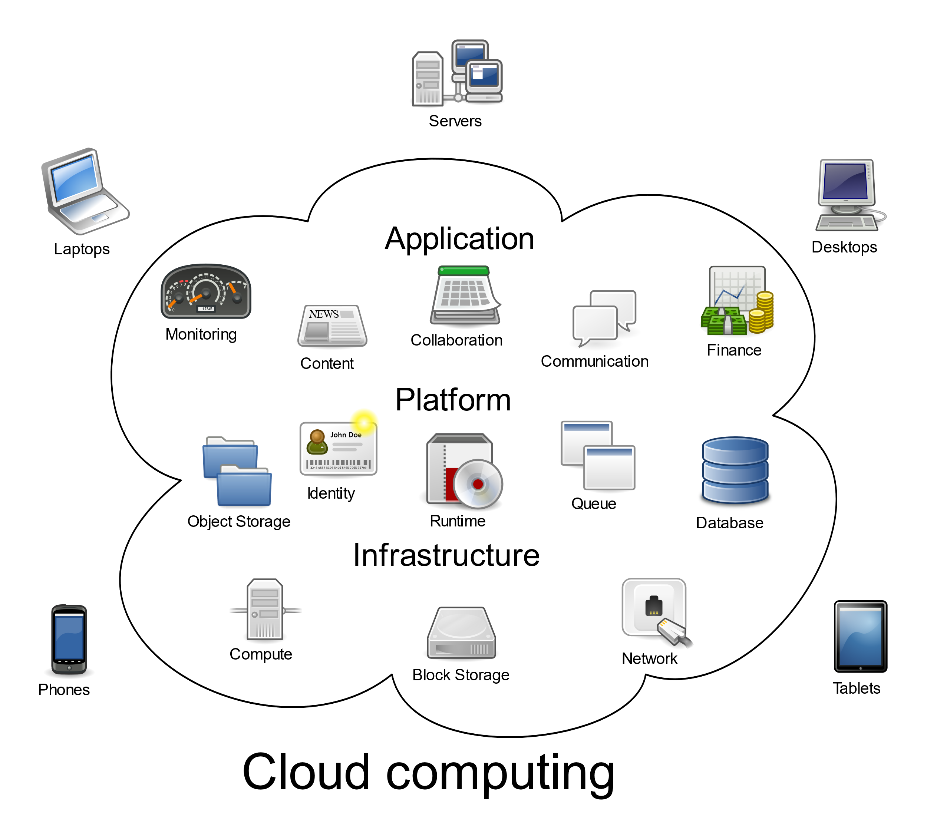
Cloud Overview
Created by Sam Johnston CC BY-SA 3.0, https://commons.wikimedia.org/w/index.php?curid=6080417
18

Slide 5
Cloud Computing Services
Software As a service (SaaS)
- Applications are hosted and maintained by vendors for use by customers. Example: Gmail, Messenger
Platform as a service (PaaS)
- This gives the option for customers to focus on applications without worrying about the underlying infrastructure (hardware, OS, networking, Databases etc) : Google app engine
Infrastructure as a service (IaaS)
- Provides the basic building blocks of any IT infrastructure like computing (vms), networking, storage and Backup etc. AWS EC2, Azure VMs, Networks etc.
17

Slide 6
Benefits of Cloud computing
Agility
Elasticity
Cost Savings
Deploy Globally
4

Slide 7
Virtualization and Cloud Computing
Virtualization is the underlying technology behind cloud computing.
Allows unused compute/ hosting resources to be used

Slide 8
Demo

